Slide 1




digital metacarpus
supervised by :
Prof. Ali Haidar
Eng. Hafez Al Khatib
Eng. Hassan Fayad
01
Mohamad Ghoush 202300735
Wafik Ibrahim 202301238
Abed Al Rida Nehme 202303149
Mostafa Ajineh 202304458

Slide 2

Key Problems
-Doctor’s physical unavailability
-Time-sensitive operations
02
Introduction

Slide 3
Key Problems
-Doctor’s physical unavailability
-Time-sensitive operations
02
Introduction
Purpose
-To enable remote surgical control via robotic arm for doctors

Slide 4
Key Problems
-Doctor’s physical unavailability
-Time-sensitive operations
02
Introduction
Purpose
-To enable remote surgical control via robotic arm for doctors
Key solutions
-Real-time gesture control with the IMU sensors
-Patient monitoring and AI integration

Slide 5
03
Remote control of robotic arm
1
Gesture-based motion control
2
Real-time feedback with patient vitals
3
Integration of data inputs
4
Addressing doctor unavailability
5
Objectives

Slide 6
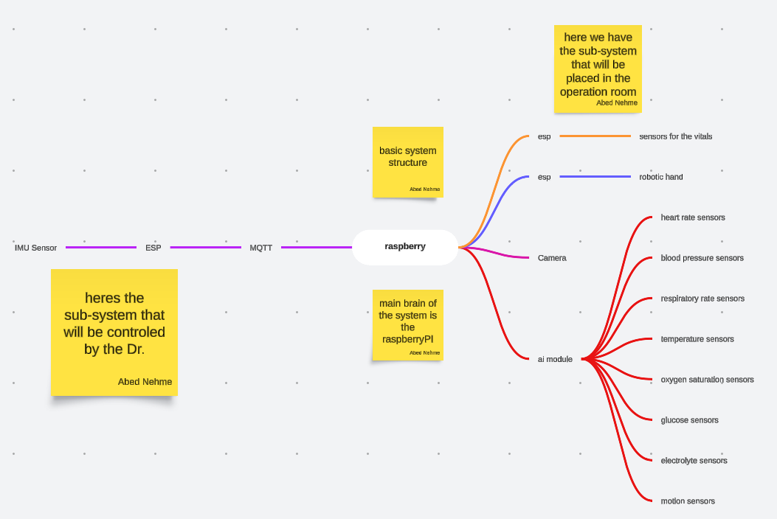
04
Components
IMU sensors
We used the 10DOF version to control the tilt, rotation and movement of the hand
ESP8266
We used it to ensure good communication and ensure a good data logging and good control
Raspberry Pi
We used the 10DOF version to control the tilt, rotation and movement of the hand
System architecture
camera

Slide 7
Key components
05
Controlling side
Controlled side
IMU sensors on glove
ESP8266 for Wi-Fi communication
Raspberry Pi for processing
Servo motors for arm movement
Camera for live video
Virtual sensors (Hear-Rate, Bp ,etc…)

Slide 8


06
Data Transmission and MQTT
Why MQTT?
Role
MQTT
Optimized for IoT
Low latency and lightweight
Sends IMU sensor data and receives video/vital feedback
Lightweight protocol for IoT

Slide 9
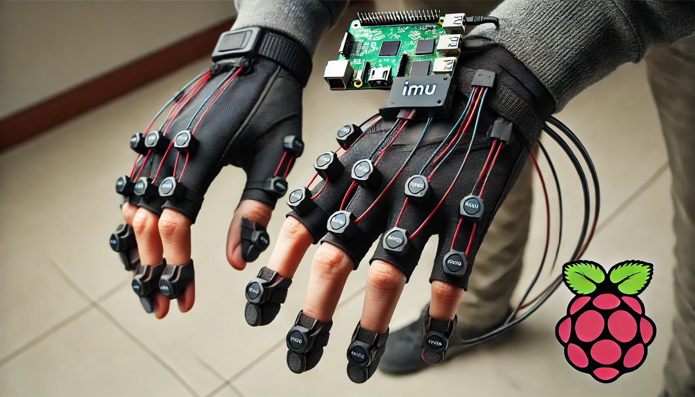
Software Development
Programming tools:
07
Python Libraries
Motor Control : RPI , GPIO, Pigpio.

Slide 10
Software Development
Programming tools:
07
Python Libraries
Motor Control : RPI , GPIO, Pigpio.
Data Processing
Analyze IMU data -> Control servo motors
Integrate Ai insights for doctor assistance

Slide 11
Software Development
Programming tools:
07
Python Libraries
Motor Control : RPI , GPIO, Pigpio.
Data Processing
Analyze IMU data -> Control servo motors
Integrate Ai insights for doctor assistance
Calibration
Ensures precision of sensors

Slide 12
System Accuracy
08
Results and Evaluation
95% motion detection accuracy

Slide 13
08
Results and Evaluation
Key achievements
Gesture control and motor Operation successful
Integration of data and real-time feedback

Slide 14
Data transmission
08
Results and Evaluation
The connection between the raspberry pi and the ESP was successful to a certain level

Slide 15
Technical Challenges
Sensor drift and inaccuracy
Network latency issues
Power supply stability
Challenges

Slide 16
Challenges
Mitigation
Identify and Assess Risks
Implement Preventive Measures
Monitor and Adjust

Slide 17

10
Future Work
enhancements
Use high-definition cameras
Optimize motors and robotic arm design
Use dedicated servers for communication

Slide 18


10
Future Work
Integration Options
enhancements
Use high-definition cameras
Optimize motors and robotic arm design
Use dedicated servers for communication
-Combine IMU sensors with camera-based gesture recognition

Slide 19


10
Future Work
Broader Applications
Integration Options
enhancements
Use high-definition cameras
Optimize motors and robotic arm design
Use dedicated servers for communication
-Manufacturing, Healthcare, Robotics, Research
-Combine IMU sensors with camera-based gesture recognition

Slide 20

10
Future Work
Broader Applications
Integration Options
enhancements
Use high-definition cameras
Optimize motors and robotic arm design
Use dedicated servers for communication
-Combine IMU sensors with camera-based gesture recognition
-Manufacturing, Healthcare, Robotics, Research

Slide 21
Biomedical Field
Remote surgeries, rehabilitation
Industrial use
Material handling, precision tasks
Research
Automation in various sectors
Practical Applications

Slide 22
-The project successfully demonstrated the integration of hardware and software to remotely control a robotic arm, achieving its primary objectives.
12
Conclusion
-The challenges faced provided valuable learning experiences, enhancing technical and problem-solving skills.
-Future improvements will focus on increasing precision, optimizing communication, and exploring real-world applications in fields like automation and manufacturing.

